Slide 1


CS1010: Programming Methodology
The Mega Recap
Live Q&A
https://pollev.com/jin

Slide 2

Objectives
Learn about fundamental concepts of problem solving by computing and programming
Become proficient with C and associated programming tools
The module is NOT just about C!

Slide 3
Week 13: The Mega Recap
Algorithmic Problem Solving
Data Structures, Control Structures and Practical Algorithms
Good Coding Habits
Program Analysis
Computer Memory
Syntax of C
Case Study: PE2

Slide 4
Algorithmic Problem Solving
The Problem
The Process
The Techniques

Slide 5
The Problem
Computational Problems
have well-defined inputs, outputs, and constraints
can be solved step-by-step by a computer
Example
Is 1933091 prime?
Find a route from Point A to Point B.
How many different routes are there from Point A to Point B?
Find the shortest route from Point A to Point B.

Slide 6
The Process
Determine problem features
Analysis
Iterative process
Write algorithm
Design
Produce code
Implementation
Check for correctness and efficiency
Testing

Slide 7
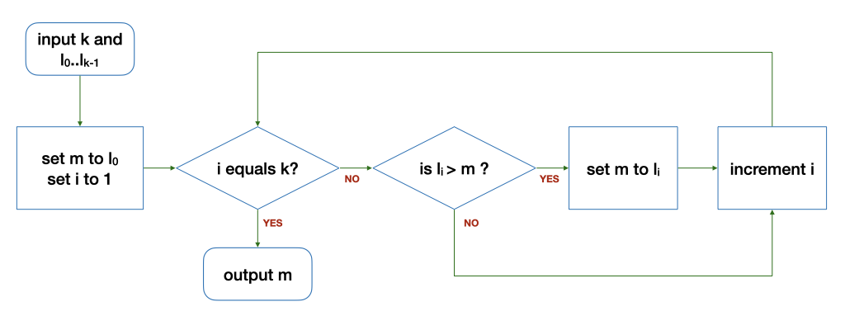
Algorithm: Example
The Flowchart
The loop
Input: 5 9 8 1 3 2
Tracing (Algorithm) is important!
k | i | l_{i} | m | Remark
6 | 1 | 9 | 5 | Before the loop
6 | 2 | 8 | 9 | After 1st round of the loop
6 | 3 | 1 | 9 | After 2nd round…
k | i | l_{i} | m | Remark
6 | 4 | 3 | 9 | After 3rd round…
6 | 5 | 2 | 9 | After 4th round…
6 | 6 | - | 9 | After 5th round…

Slide 8
The Techniques
Problem: Find the range (i.e., max-min) of a list of numbers
Algorithm:
Input: Read in a list L of k numbers (ReadInput)
Compute:
Compute the maximum of a list L of k numbers (FindMax)
Compute the minimum of a list L of k numbers (???)
Compute the difference between the maximum and the minimum (Arithmetic computation)
Output: Print the range (PrintOutput)
1. Breaking it down!
2. Borrowing from what we know!
3. Wishful thinking! (Functions)

Slide 9
Data Structures
Types
Basic Data Types
Arrays
Structures
How to…
Declare
Initialize
Access
Pass
Update

Slide 10
Basic Data Types
For storing single values
Examples
long value; 4/8 bytes, signed
char ch; 1 byte
double ave; 8 bytes

Slide 11
Array
For storing multiple values of the same type
Declaring and initializing an array.
long days(long month)
{
long days_in_month[12] = {31, 28, 31, 30, 31, 30, 31, 31, 30, 31, 30, 31};
long days_since = 0;
for (long i = 0; i < month - 1; i += 1) {
days_since += days_in_month[i];
}
return days_since;
}
Iterating through the array.

Slide 12

String
A char array terminated by a null character '\0' (which has the numeric value 0)
char hello1[7] = {'h', 'e', 'l', 'l', 'o', '!', '\0'};
char hello1[7] = {'h', 'e', 'l', 'l', 'o', '!', 0};
These two are the same!
char hello1[7] = {'h', 'e', 'l', 'l', 'o', '!'};
Not a string. Strange errors may occur.
char hello2[7] = "hello!";
char hello3[] = "hello!";
These are ok as well!
hello1[1] = 'v';
Individual elements can be accessed / modified.

Slide 13
Multi-dimensional Arrays
In general, an array can have any number of dimensions
Example of a 2-dimensional (2D) array:
// array with 3 rows, 5 columns
long a[3][5];
a[0][0] = 2;
a[2][4] = 9;
a[1][0] = a[2][4] + 7;
0
1
2
3
4
0
2
1
16
2
9
Arrays are stored in row-major order
That is, elements in row 0 comes before row 1, etc.
a[0][0]
…
a[0][4]
a[1][0]
…
a[1][4]
a[2][0]
…
a[2][4]
row 0
row 1
row 2

Slide 14
Organizing Data
Write a program to compute the volume of 2 boxes.
// for 1st box
long length1;
long width1;
long height1;
// for 2nd box
long length2;
long width2,
long height2;
length1
width1
height1
length2
width2
height2
More logical to organize the dimensions into a group and declare two variables of such a group.
box1
box2
length
width
height
length
width
height

Slide 15
Control Structures
Types
Sequence
Selection
Repetition
How to …
Decide the correct sequence
Write the correct logical expression

Slide 16
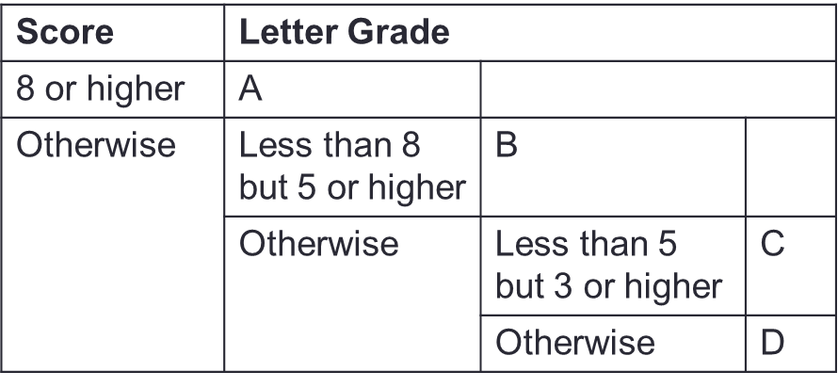
Nested if-else Statements
Problem: Print a letter grade based on a score
…
if (score >= 8) {
// print "A"
} else {
if (score >= 5) {
// print "B"
} else {
if (score >= 3) {
// print "C"
} else {
// print "D"
}
}
}
…

Slide 17
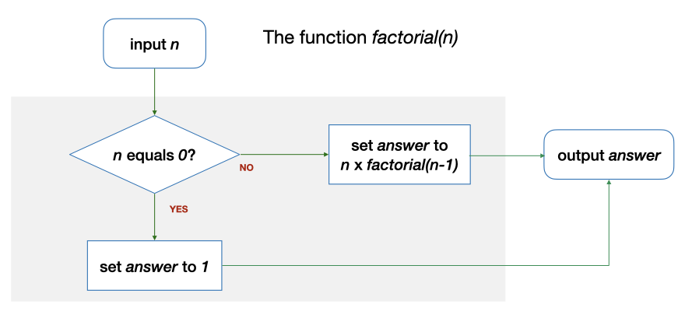
Repetition through Recursion
factorial(2) requires factorial(1), which in turn requires factorial (0)
long factorial(long n)
{
long answer;
if (n == 0) {
answer = 1;
} else {
answer = n * factorial(n - 1);
}
return answer;
}

Slide 18
Common Types of Recursion
Integers
Base case: a single digit or 0
Recursive case: number – 1 or number / 10
Example: factorial, sumDigits
1D arrays (including strings)
Base case: an array of 1 element or an empty array
Recursive case: the array minus the first / last element or the left / right half of the elements.
Example: findMax, binarySearch
2D arrays
Base case: a single row / column or an empty array
Recursive case: the array minus one row / column

Slide 19
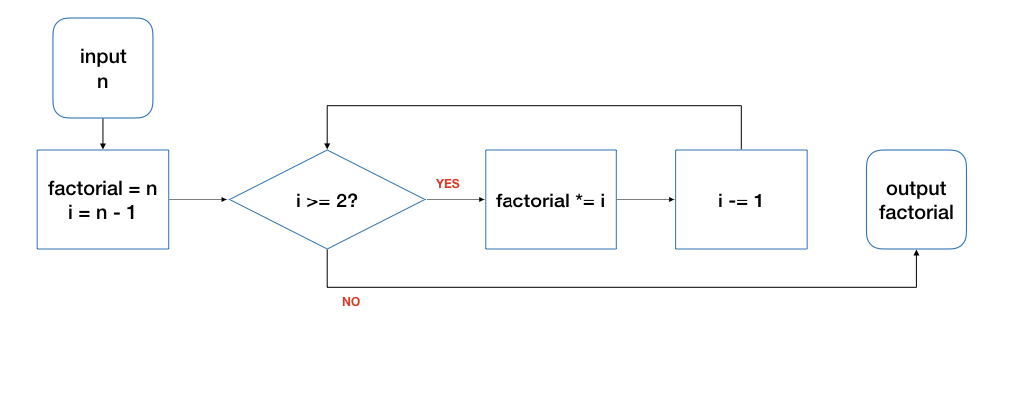
Repetition through Loops
Good for repetitions that have an explicit start / end / update.
long factorial(long n)
{
long product = n;
for (long i = n - 1; i >= 2; i -= 1) {
product *= i;
}
return product;
}

Slide 20
Practical Algorithms
Searching
Sorting

Slide 21
Linear Search
Also known as Sequential Search
Idea: Search the list from one end to the other end in linear progression.
Algorithm:
Example: Search for 24 in this list
// Search for key in list A with n items
linear_search(n, list, q)
{
for i = 0 to n-1
if list_{i} is q then report i
}
87 12 51 9 24 63
no
no
no
no
yes!
Return 4
What to report if key is not found?
Aim for a clean design

Slide 22
Binary Search
Example: Search key = 23
arr
[0]
[1]
[2]
[3]
[4]
[5]
[6]
[7]
[8]
5
12
17
23
38
44
77
84
90
Found!
Return 3
1. start = 0, end = 8, mid = (0+8)/2 = 4
arr[4] = 38 > 23
2. start = 0, end = 3, mid = (0+3)/2 = 1
arr[1] = 12 < 23
3. start = 2, end = 3, mid = (2+3)/2 = 2
arr[2] = 17 < 23
4. start = 3, end = 3, mid = (3+3)/2 = 3
arr[3] = 23 == 23

Slide 23
Counting Sort
in
[1]
[3]
[4]
A list of 6 items in the range of [1, 9]
[0]
[2]
[5]
5
5
3
2
8
2
freq
[1]
[3]
[4]
[9]
[0]
[2]
[5]
[6]
[7]
[8]
10 slots in the freq array.
0
0
2
1
0
2
0
0
1
0
out
[1]
[3]
[4]
[0]
[2]
[5]
2
2
3
5
5
8

Slide 24
Selection Sort
n = 9
max
last
array
[1]
[3]
[4]
[0]
[2]
[5]
[6]
[7]
[8]
1st pass:
23
17
5
90
12
44
38
84
77
max
last
2nd pass:
23
17
5
77
12
44
38
84
90
max
last
3rd pass:
23
17
5
77
12
44
38
84
90
max
last
4th pass:
23
17
5
38
12
44
77
84
90

Slide 25
Bubble Sort: One Pass
0
1
2
3
4
5
6
7
8
23
17
5
90
12
44
38
84
77
17
5
23
12
44
90
38
84
77
exchange
exchange
17
23
5
90
12
44
38
84
77
17
5
23
12
44
38
90
84
77
exchange
exchange
17
5
23
90
12
44
38
84
77
17
5
23
12
44
38
84
90
77
exchange
ok
exchange
17
5
23
12
90
44
38
84
77
17
5
23
12
44
38
84
77
90
exchange
Q: Is the array sorted?
Q: What have we achieved?
Done!

Slide 26
Insertion Sort
Sorted region
a [0] [1] [2] [3] [4]
Pass 1
Pass 2
10
5
7
1
6
Where to insert a[1] in the sorted region to its left?
5
10
7
1
6
5
10
7
1
6
Where to insert a[2] in the sorted region to its left?
5
7
10
1
6

Slide 27
Good Coding Habits
Writing Efficient Code
Incremental Coding
Style
Documentation

Slide 28
Good Habits for Writing Efficient Code
No redundant work
Do only what is necessary.
bool is_prime(long n){
for (long i = 2; i <= n - 1; i += 1) {
if (n % i == 0) {
return false;
}
}
return true;
}
100 seconds vs 3 seconds on is_prime(10000000001)!
bool is_prime(long n){
for (long i = 2; i <= sqrt(n); i += 1) {
if (n % i == 0) {
return false;
}
}
return true;
}
This is more efficient!

Slide 29
Good Habits for Writing Efficient Code
No duplicates
Do NOT repeat work.
Example:
Compute the range of a list of k numbers.
Solution 1
Go through the list once to compute the maximum
Go through the list (again) to compute the minimum
Compute maximum – minimum
Solution 2
Go through the list once to compute both the maximum and the minimum at the same time
Compute maximum – minimum
This is more efficient!

Slide 30
N Queens
Incremental Coding
int main(){
long n = cs1010_read_long();
char *queens;
queens = malloc((size_t)(n + 1) * sizeof(char));
free(queens);
}
Focus on the main function.
Compile and test using clang and a small n (e.g., 4).
(No outputs yet.)

Slide 31
N Queens
Incremental Coding
void nqueens(char queens[], long n, long row) {
cs1010_println_string(queens);
}
int main(){
…
char curr = 'a';
for (long i = 0; i < n; i++) {
queens[i] = curr;
curr += 1;
}
queens[n] = '\0';
nqueens(queens, n, 0);
…
}
Add initialization and placeholder for nqueens.
Compile and test.
(Output should be the default sequence.)

Slide 32
N Queens
Incremental Coding
void swap(char a[], long i, long j) {
}
bool threaten_each_other_diagonally(char queens[], long len) {
return false;
}
void nqueens(char queens[], long n, long row) {
if (row == n-1) {
if (!threaten_each_other_diagonally(queens, n)) {
cs1010_println_string(queens);
}
return;
}
nqueens(queens, n, row + 1);
for (long i = row + 1; i < n; i++) {
swap(queens, row, i);
nqueens(queens, n, row + 1);
swap(queens, row, i);
}
}
Add in the recursion with placeholders for the additional functions.
Compile and test. (Output should be the default sequence printed many times.)

Slide 33

Style
For making the code neat and readable.
for(i=0;i<3;i+=1){
while(j!=i){cs1010_print_string("Hello\n");}}
for (i = 0; i < 3; i += 1) {
while (j != i) {
cs1010_print_string("Hello\n");
}
}

Slide 34
Documentation
For making the code easy to understand.
/**
* Find the number between 1 and n with the maximum * number of steps to reach 1, breaking ties by finding * the larger among these numbers.
* @param[in,out] max_num_steps The maximum number of steps
* @param[out] max_n The number with the maximum number of steps
*
* @pre max_num_steps <= 0
*/
void solve(long n, long *max_n, long *max_num_steps) {
…
}

Slide 35
Program Analysis
Correctness
Tracing (Code)
Assertion / Loop Invariant
Efficiency
Time Complexity

Slide 36
Tracing (Code)
void print_digits(long n) {
long digit;
while (n > 0) {
digit = n%10;
CS1010_print_long(digit);
n /= 10;
}
}
What are the values of n and digit at various point of time?
n: 28943
n | digit | n > 0 | Remark
28943 | - | true | Before the loop
2894 | 3 | true | After the first round…
289 | 4 | true | After the second round…

Slide 37
Assertion
Important: Write an assertion based on what should be true, not your code!
Problem: Find the maximum value between two variables
if (…) {
// { x > y }
…
// {max == x && max > y}
else {
// { x <= y }
…
// {max >= x && max == y}
}
x > y
x <= y

Slide 38
Loop Invariant
An assertion that is true before the loop, after each iteration of the loop, and after the loop.
1
2
3
4
5
6
7
8
9
10
11
12
13
14
15
16
long factorial(long n)
{
if (n == 0) { return 1; }
long product = 1;
long i = 1;
// Line A: before the loop
while (i < n) {
// Line B: beginning of each iteration
i += 1;
// Line C: …
product *= i;
// Line D: after each iteration
}
// Line E: after the loop
return product;
}

Slide 39
Time Complexity Analysis
Focus on the order of growth and the worst-case scenario.
Example
Initial computation: 7n – 12
Drop constants and keep only the term with the highest rate of growth.
Final result: O(n)
for (long i = 2; i != n; i += 1) {
first = second;
second = third;
third = first + second;
}
O(1) < O(log n) < O($\sqrt{n}$) < O(n) < O(n²) < O(n³) < … < O(2^{n}) < O(3^{n})

Slide 40
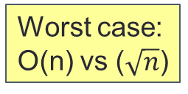
Time Complexity Analysis
Focus on the order of growth and the worst-case scenario.
Example
bool is_prime(long n){
for (long i = 2; i <= n - 1; i += 1) {
if (n % i == 0) {
return false;
}
}
return true;
}
Best case:
Both O(1)
Worst case: O(n) vs ($\sqrt{n}$)
bool is_prime(long n){
for (long i = 2; i <= sqrt(n); i += 1) {
if (n % i == 0) {
return false;
}
}
return true;
}
This is more efficient!

Slide 41
Computer Memory
Memory Address and Pointer
Call Stack and Heap
Call by Reference

Slide 42
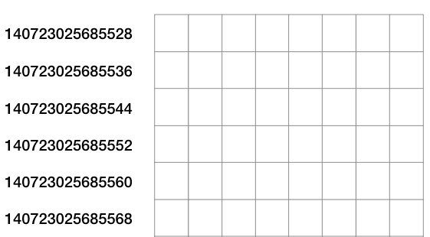
Memory Address
Every location in the memory has an address (i.e., a unique index number).
Usually we visualize the memory as a 2D grid.
What are the addresses of these slots?
140723025685542
140723025685563
Addresses for the first slot in each row.

Slide 43
Pointers
i
12
j
12
long i = 10, j = 20;
long *p; // p is a pointer to some long variable
10
20
p
p = &i; // p now stores the address of variable i
cs1010_println_long(*p);
Important!
Now *p is equivalent to i
10
// *p accesses the value of pointed/referred variable
*p = *p + 2; // increment *p (which is i) by 2
// same effect as: i = i + 2;
p = &j; // p now stores the address of variable j
Important!
Now *p is equivalent to j
*p = i; // value of *p (which is j now) becomes 12
// same effect as: j = i;

Slide 44
Call Stack
It contains Stack Frames which are
added whenever a function is called
used to store the variables of the function call.
removed when the call is done

Slide 45
Heap
Another region of the memory outside Call Stack
Manual allocation / deallocation
Life-span = from allocation to de-allocation
Bigger in size than the Call Stack
Use case:
Reserve a region for an array whose size depends on the input from the user.

Slide 46
C functions for Allocation / Deallocation
long *array = malloc(10 * sizeof(long));
Need to initialize the array afterwards.
long *array = calloc(10, sizeof(long));
No need to initialize afterwards.
Remember to do this to avoid memory leak!
free(array);

Slide 47
Call by Reference
Problem: … Print the number with the largest total stopping time and its corresponding total stopping time.
void find_max_steps(long n, long *max_n, long *max_num_steps);
int main() {
long n = cs1010_read_long();
long max_num_steps;
long max_n;
find_max_steps(n, &max_n, &max_num_steps);
cs1010_println_long(max_n);
cs1010_println_long(max_num_steps);
}

Slide 48
Call by Reference
void find_max_steps(long n, long *max_n, long *max_num_steps) {
*max_num_steps = 0;
*max_n = 1;
for (long i = 1; i <= n; i += 1) {
long num_of_steps = count_num_of_steps(i);
if (num_of_steps >= *max_num_steps) {
*max_n = i;
*max_num_steps = num_of_steps;
}
}
}

Slide 49
Array and Pointer
Example: long a[10]
a[0]
a[1]
a[2]
a[3]
a[4]
a[5]
a[6]
a[7]
a[8]
a[9]
When the array name a appears in an expression, it refers to the address of the first element (i.e. &a[0]) of that array (a.k.a., Array Decay)
These 2 outputs will always be the same.
long a[3];
cs1010_println_long((long)a);
cs1010_println_long((long)&a[0]);
cs1010_println_long((long)&a[1]);
ffbff724
ffbff724
ffbff732

Slide 50
Function Definition / Call with Array
…
int main(void) {
long foo[4] = {44, 9, 17, 1};
doubleArray(foo, 4);
return 0;
}
void doubleArray(long list[], long len) {
for (long i = 0; i < len; i++){
list[i] *= 2;
}
}
In main():
foo[0]
foo[1]
44
9
17
1
88
18
34
2
What happens if doubleArray(foo, 3) is called instead?
In doubleArray():
list
length
i
?
2
0
1
4
4
3

Slide 51
Syntax of C
How to write Arithmetic Computations / Control Structures?
How to declare, and use Data structures / Pointers / Functions?
How to manage Memory?
How to use Preprocessor Directives / assert / Standard I/O?

Slide 52
Case Study PE2 (Q1)
A sequence of n (n>=2) integers is a geometric sequence if it is in the form of {1, a, a², a³, …, a^{n-1}} where a is a non-zero integer.
For example, {1, 2, 4, 8, 16} is a geometric sequence with a = 2, while {1, 2, 3, 4, 5} is not.
Write a program geometric.c that 1) reads in a sequence of n integers, and 2) prints "Yes" if the sequence is a geometric sequence or "No" otherwise.

Slide 53
Case Study PE2 (Q1)
Analysis:
Input: A sequence of n (n>=2) integers
Output: "Yes" if the sequence is a geometric sequence or "No" otherwise.
Design:
Read in a sequence of integers
Determine if the sequence is geometric
Output Yes / No

Slide 54
Case Study PE2 (Q1)
Design:
Determine if the sequence is geometric
Check if the 1st number is 1. If not, return false.
Check if the 2nd number is non-zero. If not, return false.
For the n-th number (n >= 3), check if it is (n-1)-th number * the 2nd number (or the 2nd number to the power of n-1). If not, return false.
Return true.
A Geometric Sequence: {1, a, a², a³, …, a^{n-1}} where a is a non-zero integer

Slide 55
Case Study PE2 (Q1)
Implementation:
V1: Start with "Read input + Print Output"
int main(){
long n = cs1010_read_long();
long *sequence = cs1010_read_long_array(n);
cs1010_println_string("Yes");
cs1010_println_string("No");
free(sequence);
return 0;
}

Slide 56
Case Study PE2 (Q1)
Implementation:
V2: Add the required function (definition / call).
bool is_geometric(long sequence[], long n){ return 1; }
int main(){
…
if (is_geometric(sequence)){
cs1010_println_string("Yes");
} else {
cs1010_println_string("No");
}
…
}

Slide 57
Case Study PE2 (Q1)
Implementation:
V3: Fill in the required function.
bool is_geometric(long sequence[], long n){
if (sequence[0] != 1 || sequence[1] == 0) { return 0; }
…
return 1; }

Slide 58
Case Study PE2 (Q2)
Given a word (i.e., a sequence of one or more letters), it is possible to rotate the letters in the word k positions to the right, where k is a positive integer.
For example, if the word is "potato", the results of some of the rotations are as shown below:
k = 1: "opotat"
k = 3: "atopot"
k = 60002: "topota"

Slide 59
Case Study PE2 (Q2)
Break it down!
How to rotate 1 time?
Borrowing from what we know!
5
6
7
10
1
Where to insert a[4] in the sorted region to its left?
1
5
6
7
10

Slide 60
Case Study PE2 (Q2)
How to make it efficient? (V1)
Rotate "potato" 6 times → "potato"
Only need to rotate k % n times.

Slide 61
Case Study PE2 (Q2)
How to make it efficient? (V2)
Rotate "potato" 3 times → "atopot"
arr[0] goes to arr[3]
arr[1] goes to arr[4]
arr[2] goes to arr[5]
arr[3] goes to arr[0]
…
arr[i] goes to arr[(i+k) % n]!
Need to be careful about overwriting the values.

Slide 62
Case Study PE2 (Q3)
Write a program bingo.c that 1) takes in a 5 x 5 marked card, and 2) outputs the number of winning rows and the number of winning columns.
0 0 0 1 0
1 1 1 1 1
0 0 0 1 0
0 1 0 1 0
0 0 1 1 0

Slide 63
Case Study PE2 (Q3)
A winning row: row sum == 5
A winning row: column sum == 5
0 0 0 1 0
1 1 1 1 1
0 0 0 1 0
0 1 0 1 0
0 0 1 1 0

Slide 64
Case Study PE2 (Q3)
CONSTRAINT: Your program must contain a function
void compute_winning(long card[][5], ...)
to compute and return the number of winning rows and the number of winning columns.
Hint: The size of the card is fixed and the input can be considered as a sequence of 25 individual numbers.
Just use a fixed size 2D array and cs1010_read_long() 25 times!

Slide 65
Case Study PE2 (Q3)
CONSTRAINT: Your program must print the answers in the main() function itself.
Use Call by Reference to return two values!

Slide 66
Case Study PE2 (Q4)
Write a program meals.c that 1) takes in the number of meals, the budget, the cost of each healthy meal and the cost of each unhealthy meal (in this particular order), and 2) outputs all possible meal plans that meet Mr. Hungry's requirements (in alphabetical order).
4 100 40 10
HUHU
UHHU
UHUH

Slide 67
Case Study PE2 (Q4)
plans({}, 0, 4, 100, 40, 10)
→ plans ({H}, 1, 4, 60, 40, 10)
→ …
→
→ plans ({HUHU}, 4, 4, 0, 10)
→ plans ({U}, 1, 4, 90, 40, 10)
→ plans ({UH}, 2, 4, 50, 40, 10)
→ …
4 100 40 10
HUHU
UHHU
UHUH

Slide 68
Case Study PE2 (Q5)
Write a program bigram.c that 1) takes in a line of text, and 2) outputs the most frequent bigram and its frequency.
a friend in need is a friend indeed
Most frequent bigram: nd
Frequency: 3

Slide 69
Case Study PE2 (Q5)
If we are counting frequencies of individual digits (0-9), we need a 1D array of 10 slots.
So we need a 2D array of 26*26 slots to store the frequency of every letter bigram from "aa" to "zz".
The rest is just count and find max…
If line[i] == 'a' and line[i+1] == 'a', increase freq[0][0]…
a friend in need is a friend indeed
Most frequent bigram: nd
Frequency: 3

